Slide 1
Image Data Processing Pipeline

Slide 2
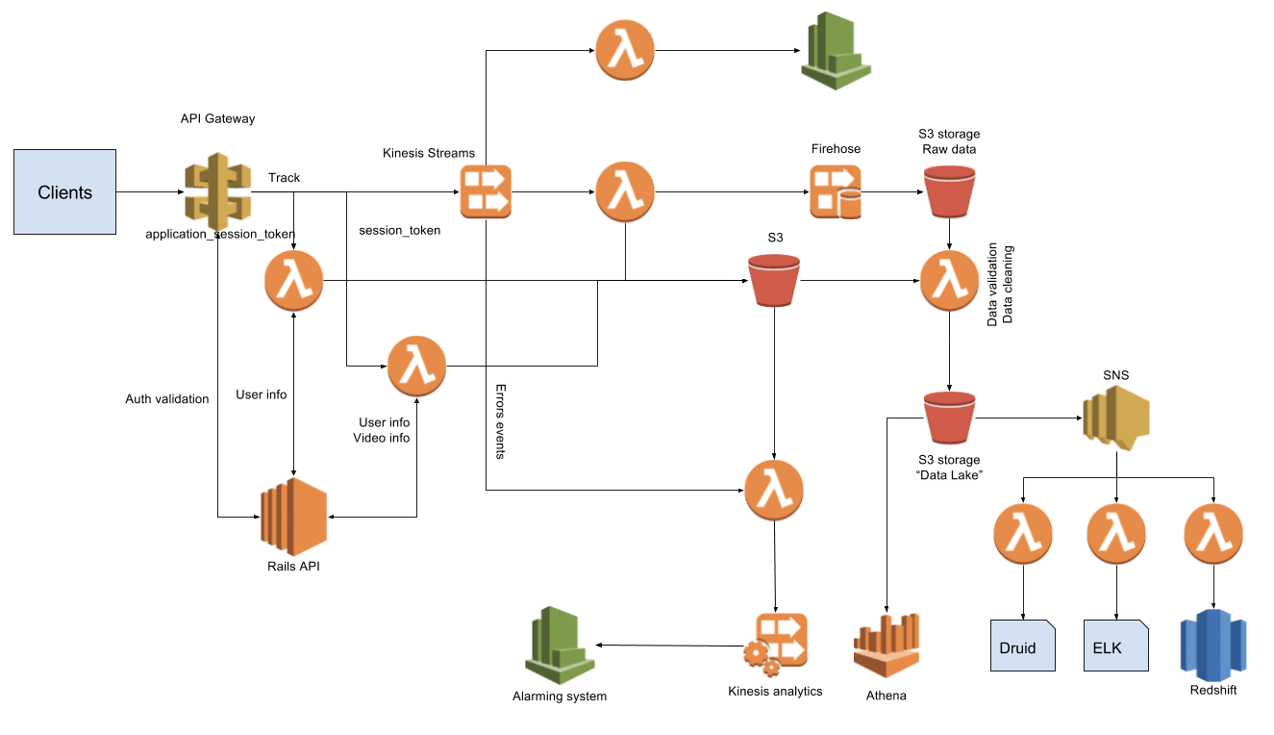

Slide 3
*7 Days archival data stored in Data-Lake “AWS S3”

Slide 4
Services used:
Amazon API Gateway
Backend API
Amazon Kinesis / Amazon Managed Streaming for Apache Kafka (MSK)
- Data Streams
- Firehose
- Analytics
AWS Lambda (Real-time)
Amazon S3 as Data-lake
Amazon Simple Notification Service
AWS Glue (Batch process)
Redshift – Datawarehouse

Slide 5
# Data schema
event types :
- image.id
- image.source
- image.type
- image.formate
- image.colour
- image.pixels
- image.width
- image.height
- image.metadata (include customer details)
- image.created_date

Slide 6
# Lambda function for getting the unified data

Slide 7
#ETL Using AWS glue for batch process

Slide 8
# Run a crawler on output data to get the schema table

Slide 9
# AWS ATHENA Table

Slide 10
# Stats View
CREATE OR REPLACE VIEW image_stats AS
SELECT
date_trunc('month', created_date) AS month,
customer,
type,
COUNT(DISTINCT id) AS number
FROM image_processed
GROUP BY created_date, customer, type

Slide 11
# Business Intelligence (BI) Using AWS Quicksight
Connect “image_stats” view to quicksight and load data to SPICE
Create Dataset
Create Analysis
Dashboard

